Slide 1
Multifamily Programs Overview
SHNNY
June 2, 2016

Slide 2
Housing Plan Update

Slide 3
Housing Plan—House NY 2020
Build NY: Creation of units across a spectrum of populations
Supportive housing
Middle income housing
Senior housing
Preserve NY: Preservation of existing housing stock
Statewide public housing
Mitchell Lamas and other affordable multifamily rental housing
Small buildings

Slide 4
Housing Plan—House NY 2020
$20B commitment to affordable housing and homelessness:
100,000 for affordable units over five years
Approximately half preservation / half new construction
Approximately half NYC / half rest of state
6,000 supportive housing units over five years
FY 2016-17 budget passed $1.9 billion in capital
MOU pending

Slide 5
Financing Approach

Slide 6
Financing Approach
Flexibility for developers to consider different options
Provide for market and site-specific needs
Encourage leverage
Advance housing goals
Coordinated investment with jurisdictions and agencies
Mixed income and mixed use development encouraged
Integrated, supportive housing encouraged

Slide 7
Resource Availability—Two Primary Methods
Unified Funding Application:
Highly competitive, single-source request for proposals process to access 9% LIHTC and a wide variety of subordinate financing resources and State Low Income Housing Credits.
Open Window Requests for Proposals:
Applications are accepted on a continuous basis for tax-exempt, taxable and 501(c)(3) bonds in addition to a wide variety of subordinate financing resources and State Low Income Housing Credits.

Slide 8
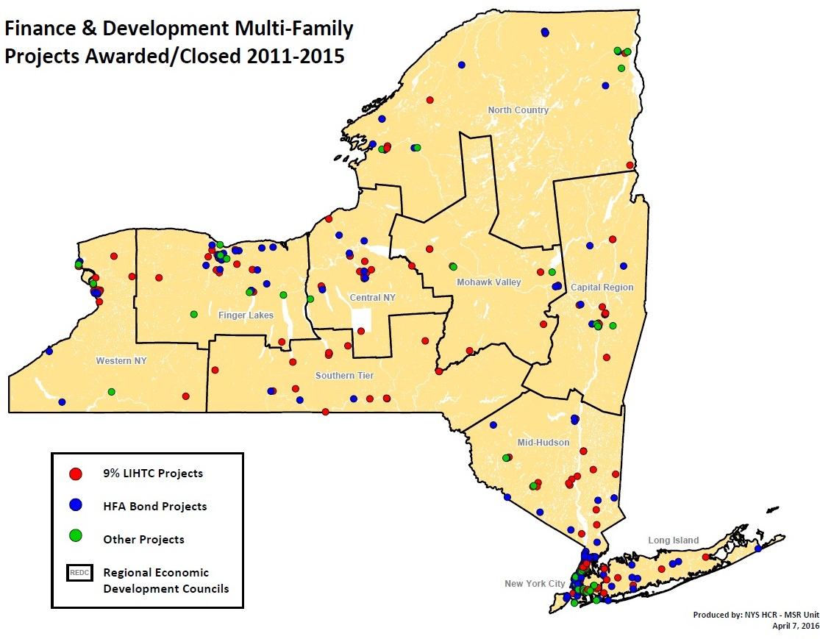
Multifamily Development Location, New York State, 2011-2015

Slide 9
Project Examples

Slide 10
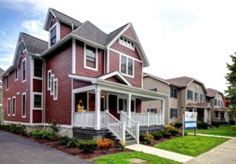
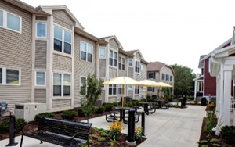
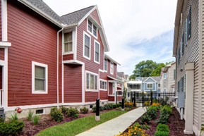
Neighborhood of the Arts - NOTA
Developer/Service Provider: DePaul
Location: Monroe County, Rochester
TDC: $11 million
Rehab and new construction of 46 units of mixed affordable and special needs housing in historic University Avenue area for households with incomes below 60% AMI.
39 units will be reserved for individuals with psychiatric disabilities and incomes at or below 30% AMI.
Financing from HTFC, City of Rochester, NYS OMH and Community Preservation Corporation.

Slide 11
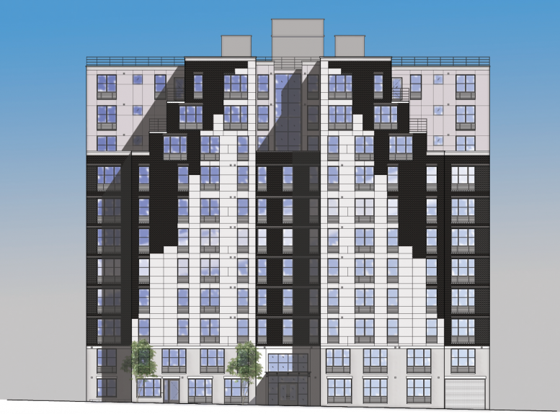
2264 Morris Avenue
Developer: Bronx Pro
Service Provider: SUS
Location: Bronx
TDC: $47 million
New construction of 94 units of mixed-income affordable housing, including 14 units up to 130% AMI.
31 units reserved for individuals with serious mental illness with incomes below 40% AMI.
Financing from HCR (HFA bonds, 4% LIHTC, MRT, HWF, MIHP), OMH debt service, HPD and PBVs.

Slide 12
Open Window RFP Summary

Slide 13
Funding Available
Approximately $70,000,000 for Highly Ready Projects:
New Construction Capital Program
Supportive Housing Opportunity Program
Public Housing Preservation Program
Multifamily Preservation Program
Middle Income Housing Program

Slide 14
Funding Available
Up to:
Homes for Working Families – $26,750,000
State Low Income Housing Credits – $4,000,000
Rural and Urban Community Investment Fund - $31,200,000
House NY Mitchell-Lama Program - $42,000,000
Mitchell-Lama Loan Program - $13,250,000

Slide 15
Programs

Slide 16
Supportive Housing Opportunity Program (SHOP)
Purpose
Supportive housing for families, individuals, and/or young adults
Households who are homeless and have one or more disabling or other life challenges
Unmet housing need as determined by the CoC or local planning entity
Maximum Request per Housing Unit up to 60% AMI
New York City: $200,000
Rest of State: $150,000
Additional Priorities and Requirements
Priority for projects that contain more than 50% supportive units
Developments must provide an integrated housing environment
Services and operating award or funded plan acceptable to HCR
Minimum 40 year regulatory agreement will require the number of units designated as supportive housing will remain so for at least 40 years.

Slide 17
New Construction Program (NCP)
Purpose
New construction or adaptive reuse of non-residential property
Households up to 60% of AMI
Advance housing priorities of New York State
Maximum Request per Housing Unit up to 60% AMI
New York City: $140,000
Westchester County & Long Island: $100,000
Rest of State: $75,000

Slide 18
State Low Income Housing Credits (SLIHC)
Purpose
Development of middle income housing for households up to 90% AMI
Dollar-for-dollar reduction in certain New York State taxes to investors
Maximum Request
$500,000 per project; $750,000 max for projects with a significant number of units targeted to households with incomes above 60% of AMI
$20,000 per housing unit up to 90% AMI
Middle Income Housing Program (MIHP)
Purpose
Development of middle income housing for households up to 130% AMI
Maximum Request
$5,000,000 per project

Slide 19
Rural and Urban Community Investment Fund (CIF)
Non-Residential Priorities
Address a critical unmet community need in the development’s primary market area
Ensure the continuation of traditional commercial corridors that would otherwise be disrupted by the development of ground floor residential space
Community renewal and revitalization
Maximum Request
The lesser of $1,500,000 per project or the amount needed to ensure that market rents would be sufficient to cover the cost of financing and operating the commercial, retail or community facility space of project

