Slide 1
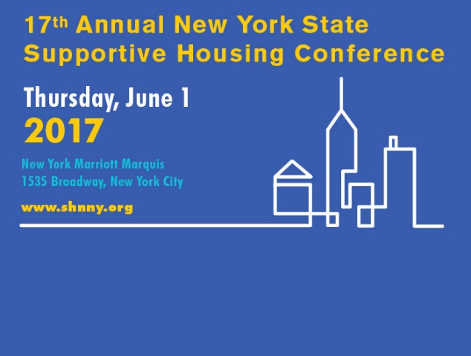
Medical Wellness Program
Presented at
Supportive Housing Network of New York’s
Annual Conference
June 2017
Medical Wellness Program
#thewayhome

Slide 2
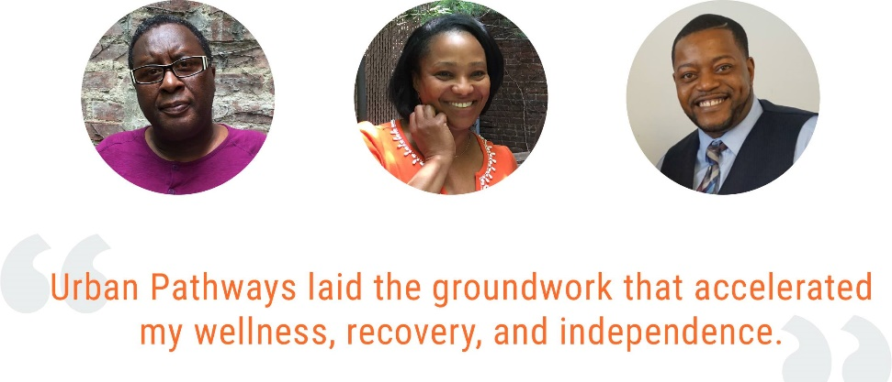
About Urban Pathways
Founded in 1975, Urban Pathways has over 40 years of experience serving vulnerable populations
Urban Pathways client profile includes homeless men and women, many of whom:
Have lived on the streets for years
Are living with mental illness and/or substance abuse disorders
Have unmet health care needs or chronic health conditions
Medical Wellness Program
#thewayhome

Slide 3
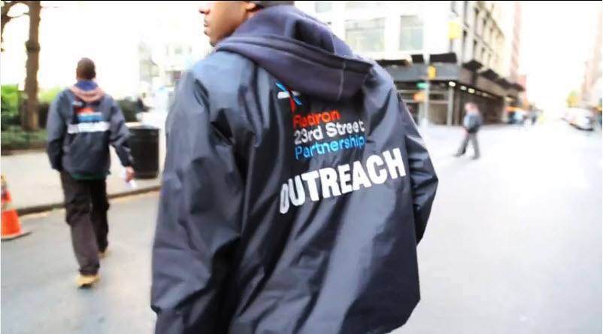
Urban Pathways Scope
Provides full range of services including:
Outreach
Drop-In Center
Safe Haven (transitional housing)
Extended-stay and permanent supportive housing
Part of the NYC Coalition on the Continuum of Care to ensure a unified response to the needs of the homeless
Works in collaboration with state and local agencies (NYS OMH, NYC DOHMH, NYC DHS) to ensure the delivery of housing and services to the homeless
Medical Wellness Program
#thewayhome

Slide 4
Health conditions of Clientele
Health conditions of the clients we serve include:
Hypertension and heart disease
Diabetes
COPD and other lung/respiratory ailments
Liver disease
HIV/AIDS
Conditions resulting from chronic poor diet
*Life expectancy for a chronically homeless adult is 42-52 years, compared to 78 years for general population¹
Medical Wellness Program
#thewayhome

Slide 5
The Problem
Chronic homelessness, SPMI and substance abuse disorders all preclude access and utilization of routine, preventive health care
Many clients have not been able to benefit from the move to enrollment in “Health Homes” being implemented in NYS
Clients do not access health care for several reasons
SPMI and substance abuse issues
“Stigma” attached to homelessness precludes many from seeking care
Clients do not understand the benefits of routine care
Reliance on expensive emergency treatment for conditions which could have been treated within a primary-care setting
System not designed for this population
Medical Wellness Program
#thewayhome

Slide 6
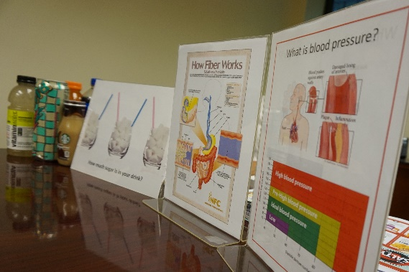
Urban Pathways’ Response
Created the Medical Wellness Program (MWP) to address several issues
Connect clients to a community-based source of primary health care
Educate clients in the appropriate use of health care resources
Educate staff on ways to assist clients to help them navigate the health care system
Reduce reliance on expensive emergency treatment
Pilot phase implemented at Hughes House in the Bronx – extended-stay supportive housing with high volume of medical incidents and large number of high-volume users of medical services
Implemented program at Ivan Shapiro House in October 2016
MWP will be organization-wide by end of 2018
Medical Wellness Program
#thewayhome

Slide 7
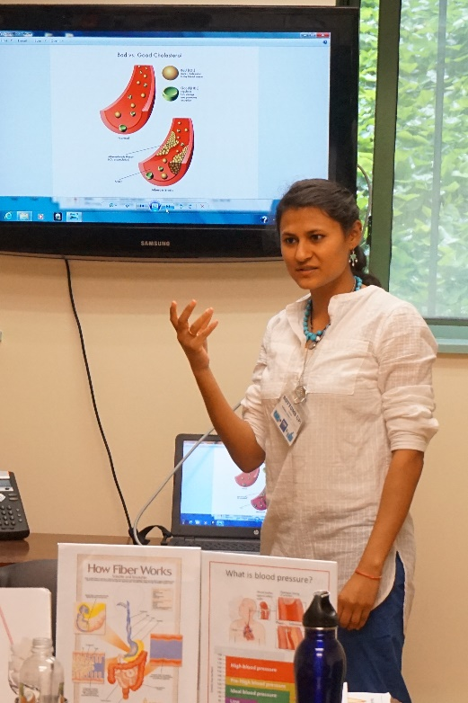
Medical Wellness Program Components
On-site staffing and holistic approach:
Full-time LPN
Assesses clients for medical needs
Connects clients to community-based health care providers
Monitors clients’ medical visits and tracks compliance, progress, etc.
Works with health care providers to educate them on health care needs of homeless adults with mental illness and/or substance use disorders
Educates clients of appropriate health care regimens to be followed for optimum physical health
Educates staff to health clients recognize their medical conditions and utilize the appropriate resources
Medical Wellness Program
#thewayhome

Slide 8
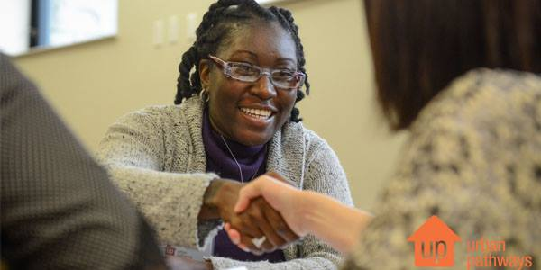
Medical Wellness Program Components Continued…
PD, DSS and Case Management Staff
Work closely with LPN to ensure that client adheres to health care regimen and keeps appointments
Assist LPN in educating clients, staff and the local health care community about the need for health care for the chronically homeless
Other staff
As “front line” staff when dealing with clients, often have established relationships of trust with clients
Assist LPN and other staff to ensure that medical issues are dealt with in an appropriate manner
Peer Specialist
“Lived experience” of Peer Specialists can help clients develop trust in program and its interventions
Can accompany clients to medical and other appointments to lessen apprehension and increase likelihood of adherence to medical regimen
Medical Wellness Program
#thewayhome

Slide 9
Medical Wellness Program PILOT PHASE – Hughes House
Hughes House, a 55 unit extended-stay supportive housing residence was chosen for the MWP pilot.
Hughes House had the highest rate of medical/psychiatric related incidents and 911 calls (911 was called 110 times during Calendar Year 2015).
Pilot Program implemented at Hughes House in January 2016
Demographics of program participants at Hughes House:
Gender: Female - 16.7%; Male - 81.5%; Transgender - 1.8%
Age: 20-29 - 16.7%; 30-39 - 22.2%; 40-49 – 13%; 50-59 – 33.3%; 60-69 – 13%; 70+ - 1.8%
Number of times homeless in past three years (prior to admission): : Never – 22.2%; One Time – 29.6%; Two Times – 20.3%; Three Times – 14.5%; Four times of more – 11.1%
Medical Wellness Program
#thewayhome

Slide 10
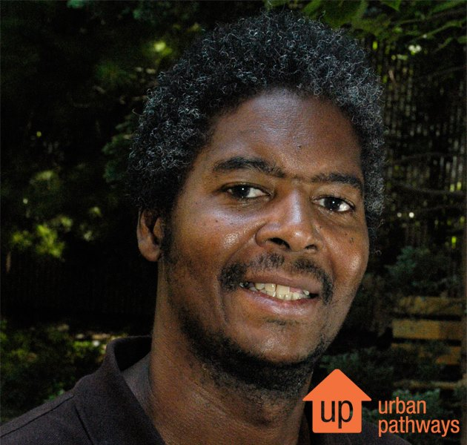
Medical Wellness Program PILOT PHASE Continued…
Program Activities – First Six Months
Hired full-time LPN
Educated clients
Assessed all clients for medical needs
Assessed clients for PCP and insurance coverage
Established relationships with local health care providers, including Essen Medical Services
Staff training in program goals and activities
Medical Wellness Program
#thewayhome

Slide 11
Hughes House PILOT PHASE Continued…
Medical Wellness Program
#thewayhome

Slide 12
Hughes House PILOT PHASE Continued…
Comparison of Data – Incident Type
(Psychiatric vs. Medical)
Medical Wellness Program
#thewayhome

Slide 13
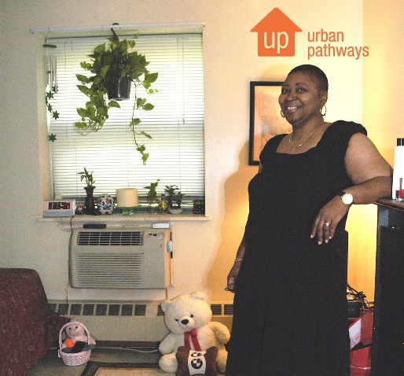
Medical Wellness Program Next steps
Addition of Medical Coordinator to MWP Staff
Responsible for implementation of program organization-wide
Works with program staff and other Urban Pathways staff to ensure that the needs of clients are met
Reviews data to determine trends and success level of MWP interventions
Develops “best practices” to be used in implementing the program throughout Urban Pathways and beyond
Roll-out of program throughout organization
Developing evidence-based “best practices” and create a white paper outlining the program, its challenges and successes
Medical Wellness Program
#thewayhome

Slide 14
Medical Wellness Program Ultimate goals
Every Urban Pathways client is connected to a source of primary care in their community
Clients follow health care regimens and do not rely on emergency care for their health needs
Overall improvement in client health
Overall reduction in use of emergency services for non-emergency medical issues
Reduction in outlay of tax dollars for health care for this challenging population
Creation of a program curriculum which can be replicated by other service providers
Medical Wellness Program
#thewayhome

Slide 15
QUESTIONS
Medical Wellness Program
#thewayhome

