Slide 1
The Buried in Treasures Workshop
Comes to Supportive Housing
Lee Shuer & Bec Belofsky Shuer
CUCS & Walter Berry
June 1st, 2017

Slide 2
Today you’ll be hearing from:
Stacy Matuza, LCSW
Deputy Chief Program Officer, CUCS
Lee Shuer & Bec Belofsky Shuer
Co-founders, Mutual Support Consulting
Christine Boehler, LCSW
Assistant Program Director, CUCS
Joseph Drucker, LMSW
Social Worker, CUCS
Ada Welch, MPA
Research and Evaluation Manager, CUCS
Walter Berry
Resident and BIT Class Graduate, The Times Square

Slide 3
Today’s program will include
An overview of Hoarding Disorder
An overview of the Buried in Treasures (BIT) Workshop
Costs/benefits of BIT Workshops vs clean-outs
An update from the Center for Urban Community Services (CUCS) regarding the implementation, outcomes, and next steps for their BIT program
A testimonial from a BIT Workshop Graduate
Time for you to ask questions

Slide 4
What is Hoarding Disorder?

Slide 5
Diagnostic Criteria: DSM-5
Persistent difficulty discarding items
regardless of value
This difficulty is due to a perceived
need to save and distress associated
with discarding
Clutter in active living areas
Significant distress and impairment

Slide 6
Specifiers
Excessive acquisition
Poor insight
2017 www.mutual-support.com

Slide 7
Steketee & Frost, 2003
Emotional Attachments & Beliefs
Vulnerabilities
Information Processing Deficits
Behavior Patterns
Clutter
Reinforcement

Slide 8
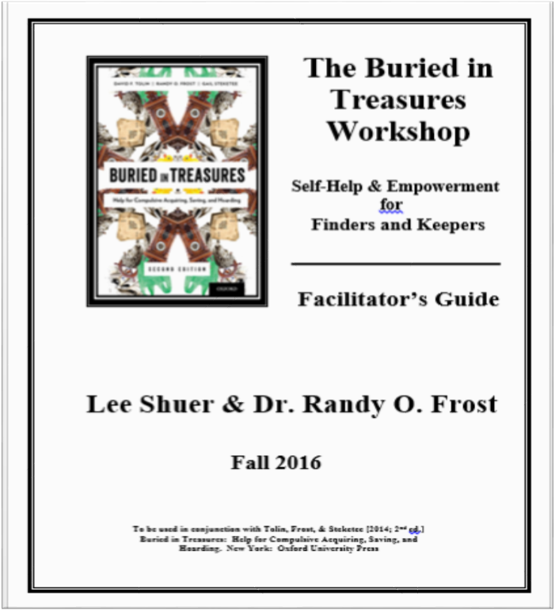
What is the BIT Workshop?

Slide 9
What is the BIT Workshop?
BIT is an action-oriented peer support group for people who want to reduce their acquiring and saving.
BIT is a harm reduction approach to making and maintaining a healthy, safe living space.
BIT groups use positive, strengths-based language to foster a sense of community, reduce shame, and bust stigma.

Slide 10
What are the goals of the program?
Help participants understand why they save things.
Teach them how to create and maintain living space they can use.
Help improve decision-making skills.
Encourage them to reduce acquiring and enjoy other activities.
Reduce clutter.
Increase quality of life!

Slide 11
What changes were made to the BIT curriculum to better suit supportive housing implementation?
The duration of the workshop was reduced from 20 weeks to 16 by removing breaks.
The duration of workshop sessions was reduced from two hours each to one hour each.

Slide 12
Costs/benefits of BIT vs forced clean-outs

Slide 13
Associated expenses of a “full clean-out”
A single clean-out costs $10,000 or more, and are often repeated.
Recovering valuables
Trash removal from premises (Hazmat, biohazard, pharmacological, etc.)
Cleaning of home and/or contents (most companies leave property “broom swept”)
Coordination of maintenance (plumbing, extermination, electrical, painting, construction, etc.)
Consultation with family, social services, mental health workers, municipality

Slide 14
Associated expenses of a fire in an apartment building
A recent apartment fire in MA cost an estimated $700,000 (In this case, nobody died)
Damage to apartment building
Water, smoke, structural
Displaced tenants
Loss of income for property owner
Disruption to the lives of neighbors
Destruction of neighbors’ personal property

Slide 15
Associated expenses of a Buried in Treasures Workshop
A copy of Buried in Treasures costs $16
The facilitator’s guide is free to download
Agencies, municipalities, and religious institutions often offer a private room for free
Facilitators may charge a fee, some volunteer. Others may facilitate as a part of their job.

Slide 16
Benefits of Buried in Treasures Workshop to individuals have included
Greater success in maintaining tenancy
A sense of pride and belonging
Stronger, more stable personal relationships
Financial stability
A brighter outlook on life
Reduced medical expenses
Less intrusion by housing-related personnel

Slide 17
CUCS Buried in Treasures Pilot
Stacy Matuza, LCSW
Deputy Chief Program Officer, CUCS
Christine Boehler, LCSW
Asst. Program Dir., The Prince George
Ada Welch, MPA
Research & Evaluation Manager, CUCS
Joseph Drucker, LMSW
Social Worker, The Times Square
Walter Berry
BIT Class Graduate, The Times Square

Slide 18
Times Square and Prince George BIT Pilot Timeline
February 2016: Monthly workgroup meetings begin
May: 3-day facilitator training w/ Mutual Support & Dr. Frost
Mid-July: Begin marketing for info sessions
July 20: Lee Shuer info sessions at both sites
August 5 – 29th: Study consenting, Pre-BIT assessments
August 30 – December 20, 2016 : BIT weekly classes!
End of Dec. 2016: Post-BIT assessments (Round 1)

Slide 19
Marketing for the BIT Groups
Major focus on Recruitment/Outreach:
1-on-1 conversations with tenants months in advance
Fliers posted in building for info session
Info session by Lee Shuer at both sites – very popular
The tenants we had “in mind” were not those who selected into the groups
Some interested tenants were provided with more appropriate referrals

Slide 20
Marketing for the BIT Groups
Info Session Flyer Example – Posted on each floor of building

Slide 21
Successes!
Response to marketing / recruitment at both sites was positive!
Both sites ended up with good-sized groups:
Times Square – 8 participants completed the class
Prince George – 6 participants completed the class
Participants reported that they liked the group – wanted to keep coming
Positive outcomes on assessments pre-post group

Slide 22
Challenges
BIT materials are written for a less urban setting
Larger homes, automobiles, etc.
Complex client histories
Impact relationship with belongings
Impact response to Buried in Treasures
Reading and homework challenges
Emotional and complex content
Group dynamics & SH setting challenges

Slide 23
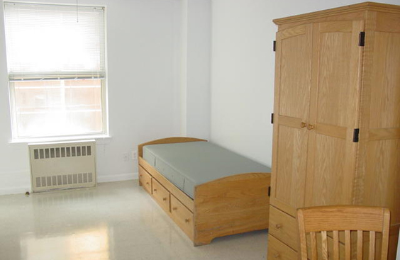
Challenges

Slide 24
Changes CUCS Made
Shorter groups
60-90 minutes instead of 120
Eliminated some indicated breaks
At tenants’ request in one case
Facilitators did not want to lose momentum
Additional facilitator assistance
Spent time going over homework material in class
Offered staff assistance in lieu of an outside “clutter buddy”

Slide 25
Ideas for Future Implementation
Facilitation considerations:
One clinical staff and one MSW intern co-facilitator
Co-facilitator to check in w/ each member individually mid-week
Keep classes short, but extend over longer time period
At 15 weeks, participants were in a more contemplative place
Additional support to integrate material
Audio version of BIT book could be helpful

Slide 26
Evaluation Results
Formal, IRB-approved study (ongoing)
Participants did not have to agree to study to be in BIT
The BIT groups were (for the most part) open
No formal diagnostic criteria required
Four pre-post assessments
Assessments will be collected again at 6 and 12 months
Participants receive $10 for each round completed

Slide 27
Evaluation Results
 | Times Square | Prince George
Facilitators | Jody Shatkin (CS) & Joseph Drucker (SW) | Christine Boehler (APD) & Alex Long (CS)
Duration | Aug. 30 – Dec. 20 2016 | Aug 31 – Dec. 14 2016
Week 1 Attendance | 11 tenants | 8 tenants
# Tenants to Complete | 8 (27% attrition) | 6 (25% attrition)
# Tenants in Study | 7 | 4
Average attendance (for those completing group) | 74% (11 classes) Low: 50% High: 100% | 68% (10 classes) Low: 40% High: 87%

Slide 28
Evaluation Results – Study participants only
Variable | Overall (n=11) | Times Square (n=7)
Age | 61.8 (10.8) | 59.3 (12.2)
Age Range | 38 - 77 | 38 - 73
% Male | 72.7 | 71.4
% Caucasian/Non-Hisp | 72.7 | 71.4
% with BA or more | 45.5 | 42.9

Slide 29
Evaluation Results- Study participants only
Variable | Overall (n=11)
Mental Health Dx | 45% Schizophrenia or Schizoaffective Disorder 63% Other mental health
Physical Health Dx | 82% One or more dx
Homelessness Hx | ~90%
Years Housed | Mean: 14.2 (SD=7.9) Min: <1, Max: 24

Slide 30
Hoarding Rating Scale and Savings Cognition Inventory
Excerpt from Hoarding Rating Scale. Tolin, D.F., Frost, R.O., & Steketee, G. (2010)
Excerpt from the Savings Cognitions Inventory. Frost, R.O., & Steketee, G. (2014)

Slide 31
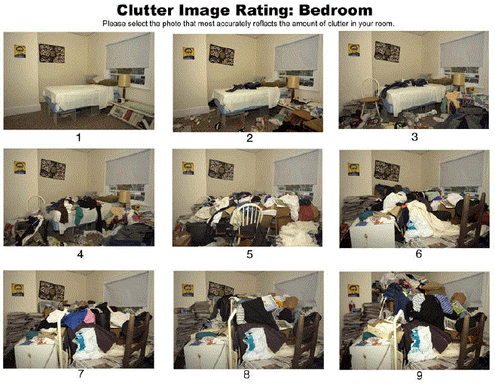
Excerpt from the Clutter Image Rating Scale. Frost, Steketee, Tolin & Renaud (2006)

Slide 32
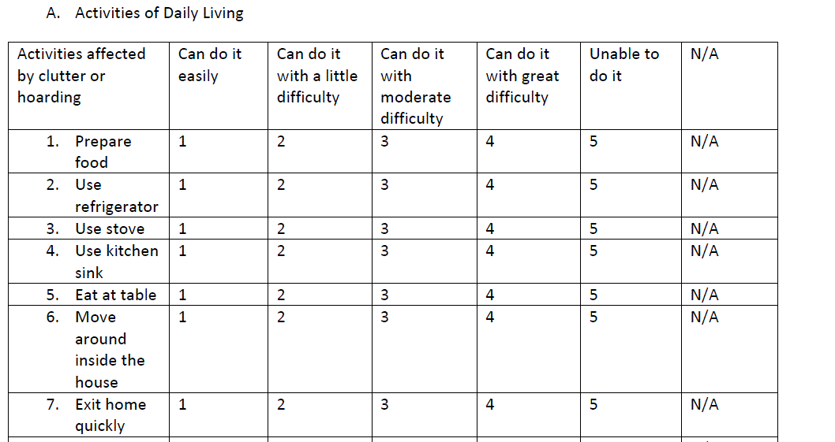
Activities of Daily Living – Hoarding sample questions
Excerpt from Activities of Daily Living – Hoarding. Frost, Hristova, Steketee & Tolin (2013)

Slide 33
Evaluation Results – Study participants only
Assessment tool | Pre (n=11) | Post (n=11)
Hoarding Rating Scale | 18.55 (7.05) | 15.10 (6.82)
Clutter Image Rating | 2.73 (1.75) | 2.6 (1.30)
ADL Subscale | 1.99 (.48) | 1.72 (.47)**
Savings Cognitions Inventory (SCI) | 112.5 (31.9) | 91.54 (33.1)**
**paired means t-test was statistically significant at alpha=.05

Slide 34
BIT Graduate Experience
A Big Welcome to
Walter Berry,
BIT Workshop Graduate!

Slide 35
Questions?

Slide 36
To contact us for more information:
Lee & Bec: www.mutual-support.com
CUCS: Stacy.Matuza@cucs.org

