Slide 1
Castle Gardens, The Fortune Society
Presented by: Derek Kelly

Slide 2
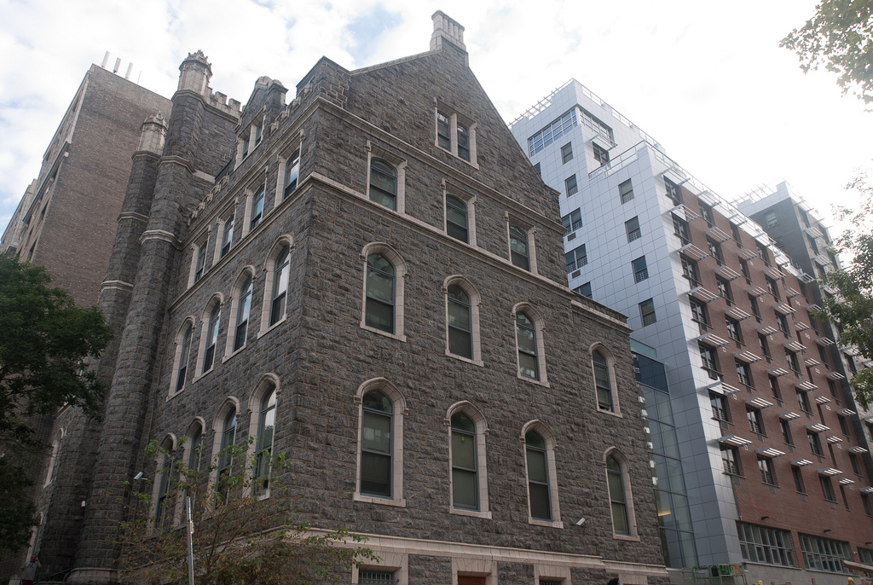
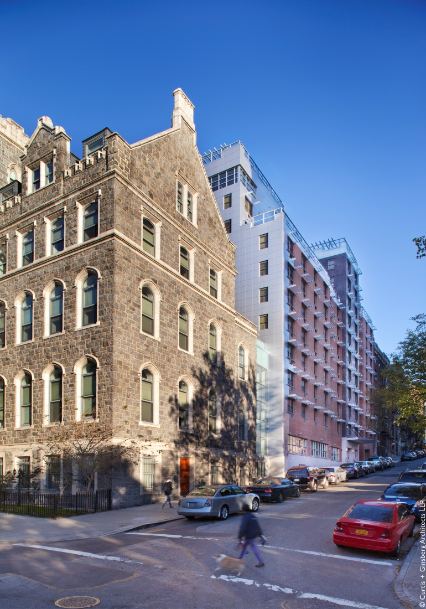
Architect: Curtis + Ginsberg Architects LLP
Developer: Lettire Construction
Landscape Architect: Donna Waldavage

Slide 3
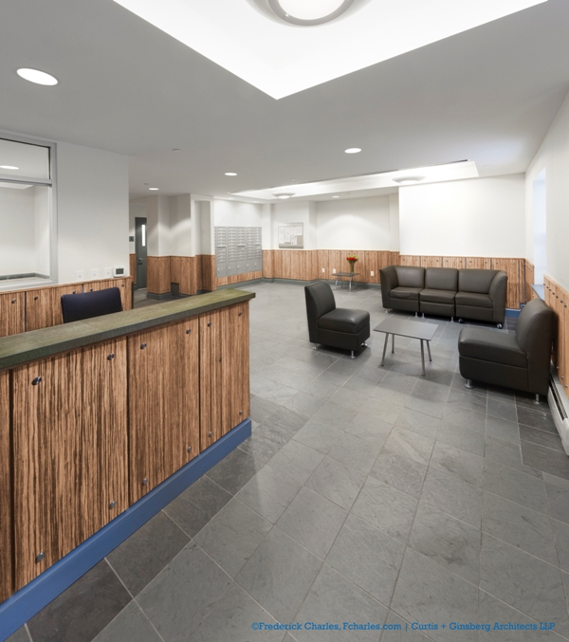
625 West 140th Street, Manhattan
114 units
Mix of 1,2, and 3 bedroom apartments

Slide 4
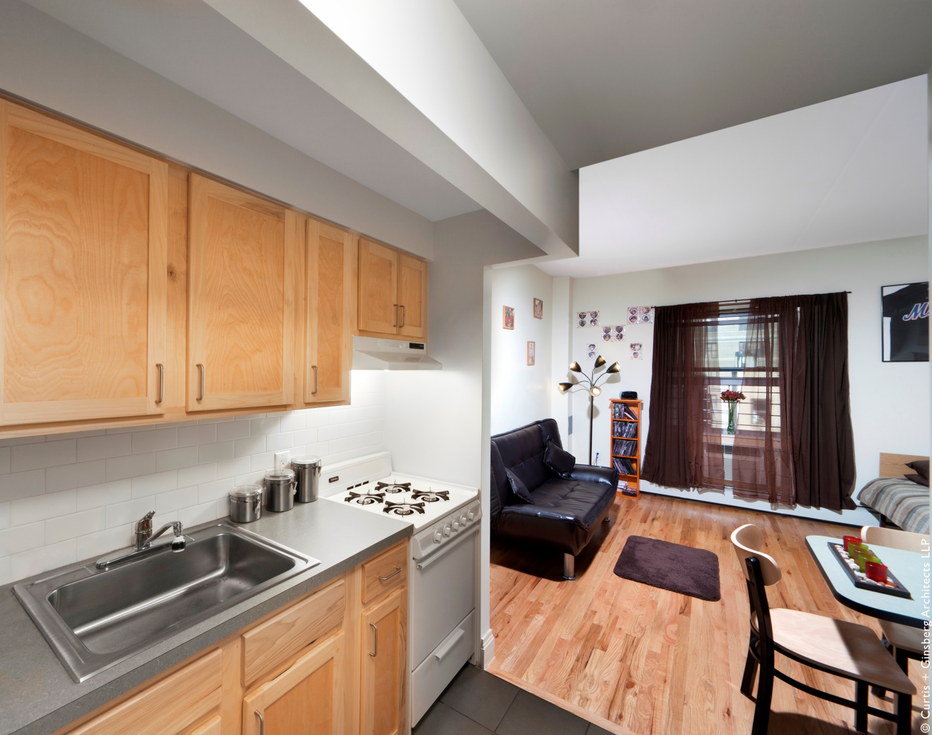

Slide 5
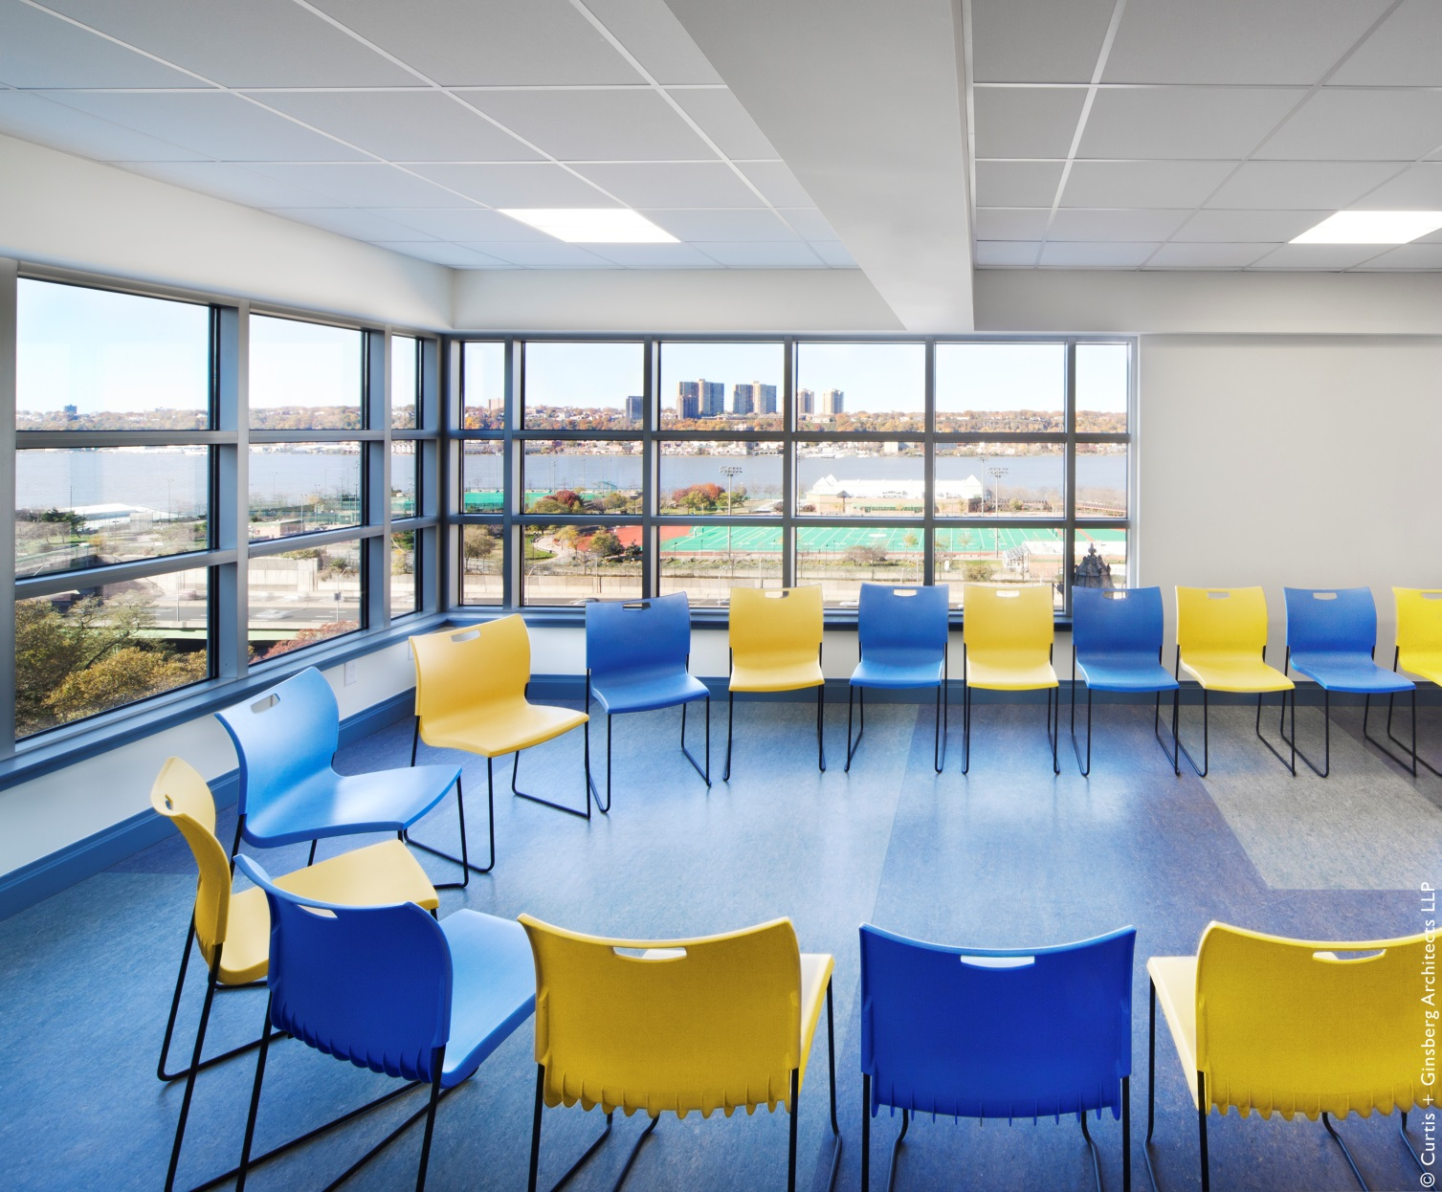

Slide 6
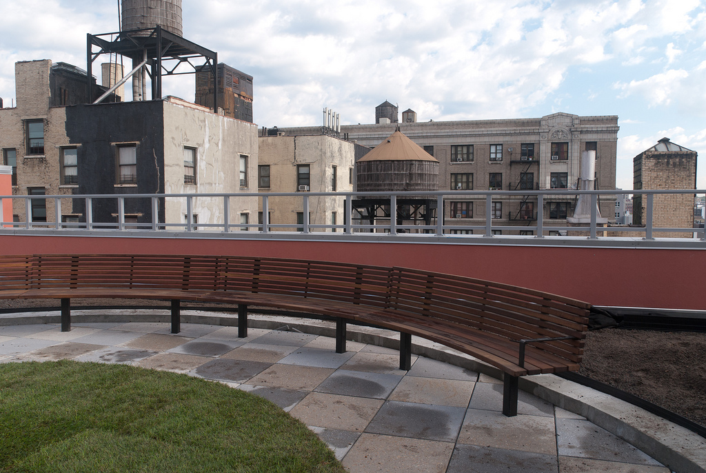

Slide 7
